Slide 1
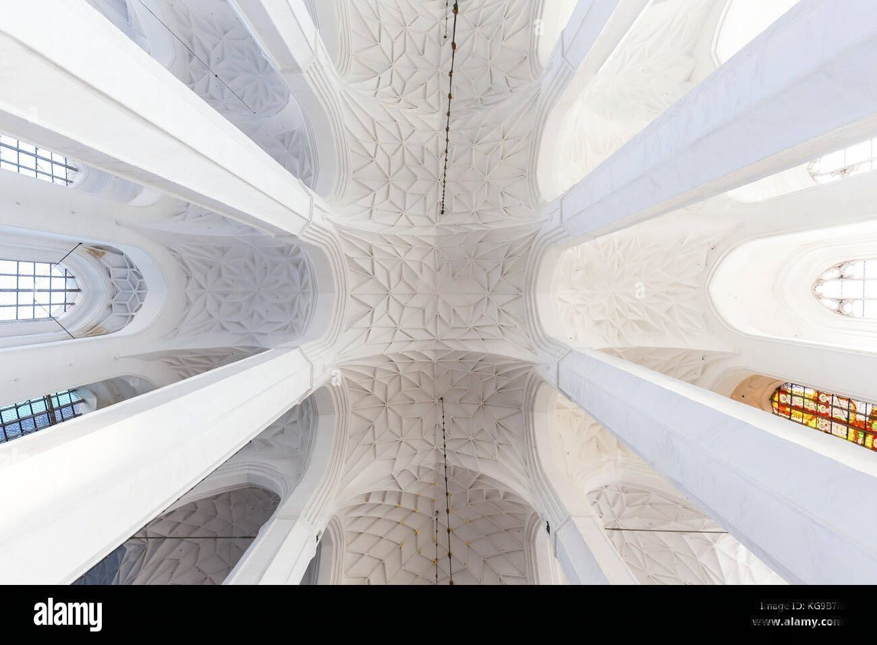
Finding beauty in Roman ceilings through Dan Brown’s eyes

Slide 2
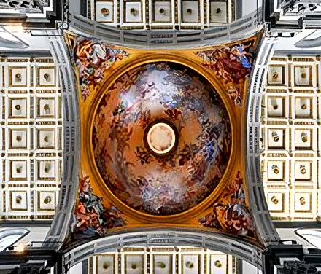
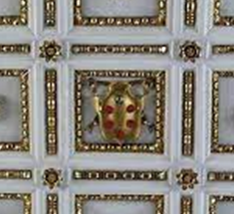
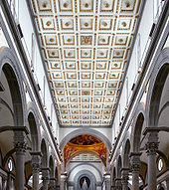

Basilica San Lorenzo, Florence, Italy Book: Inferno
Rules: 1. Golden Ratio 2. Juxtaposition 3. Framing 4. Symmetric balance 5. pattern

Slide 3
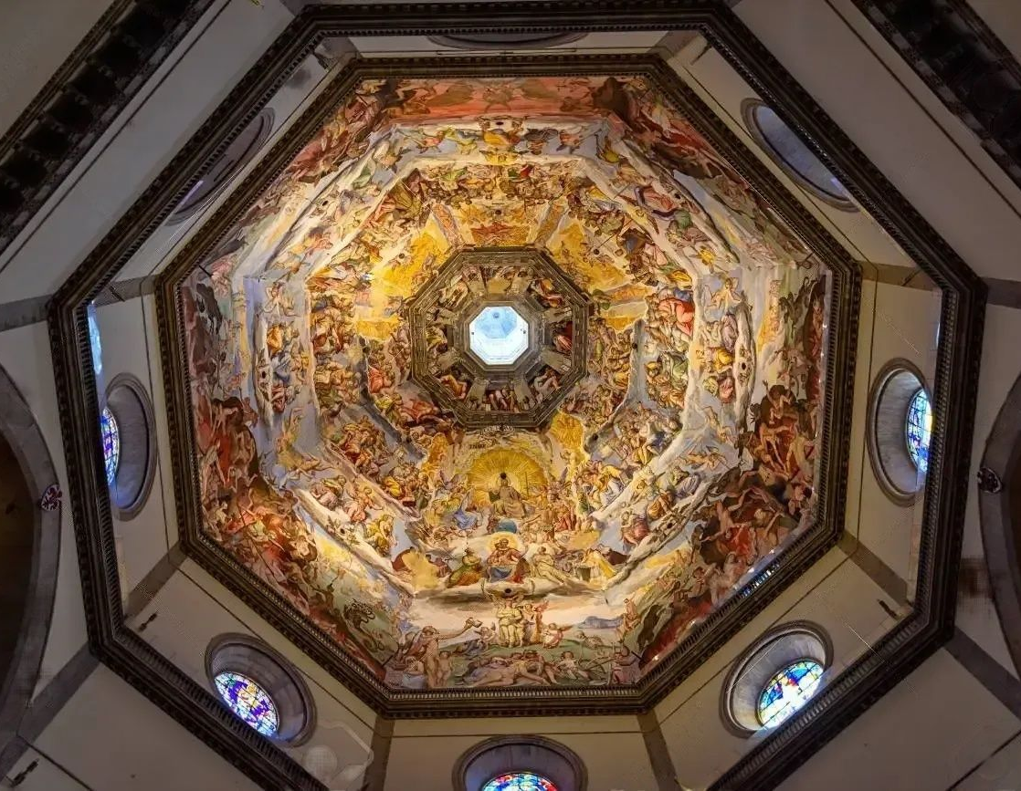
Cattedrale di Santa Maria del Fiore, Italy Book: Inferno Painting: The last judgement
Rules: 1. Golden Ratio 2. Juxtaposition 4. Symmetric balance 5. Rythm
6. Movement
7. Closure

Slide 4
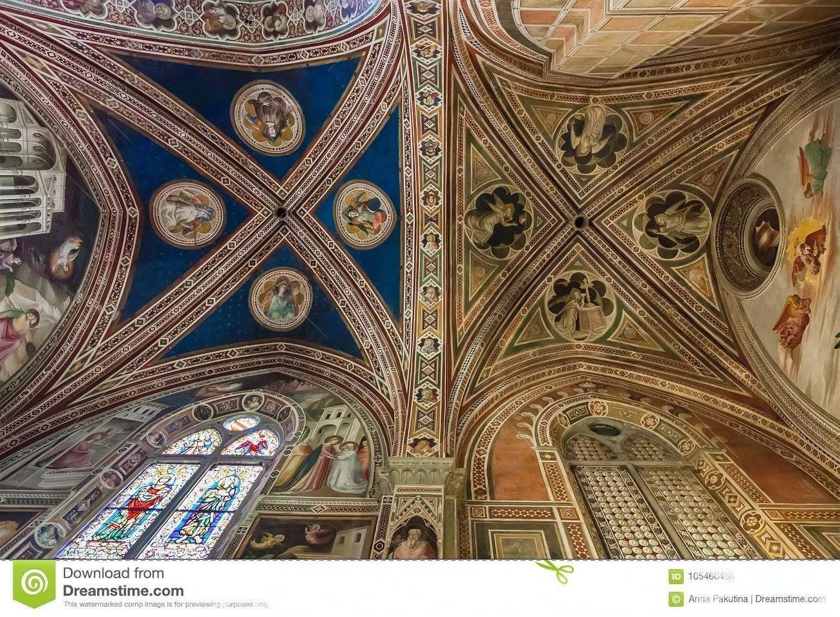
Baroncelli Chapel, Basilica di Santa Croce, Italy Book: Inferno
Rules:
1. Proximity 4. Symmetric balance

Slide 5
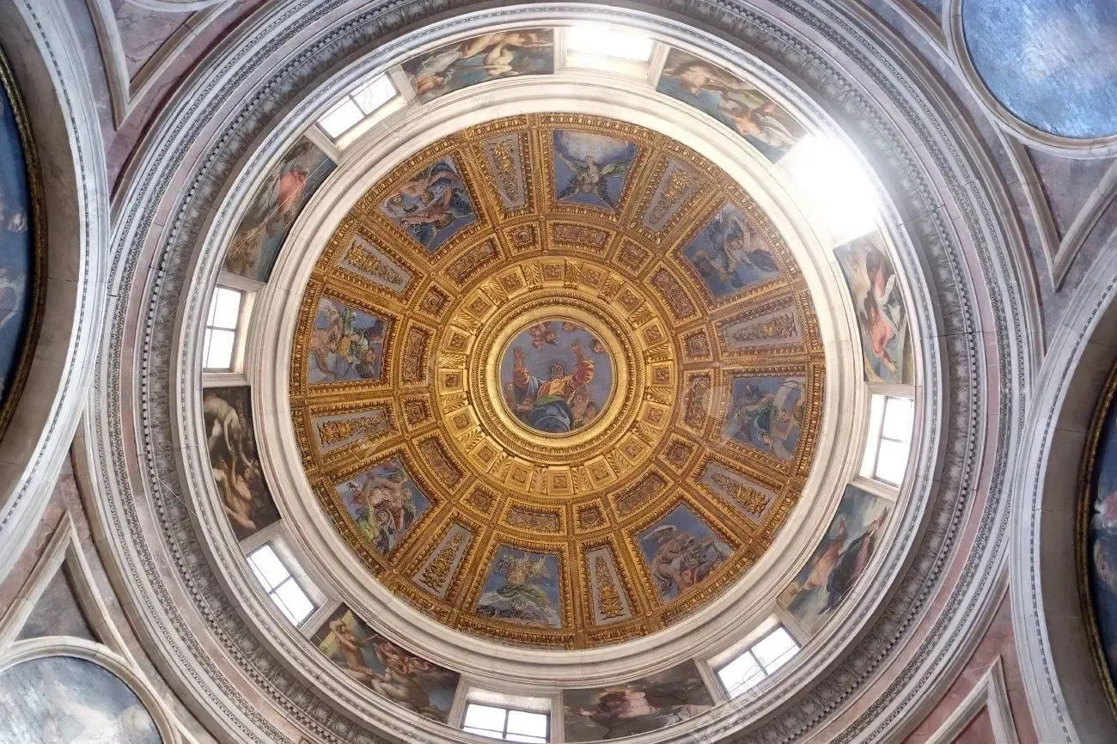
Chigi Chapel, Basilica of Santa Maria del Popolo, Rome Book: Angels and Demons
Rules:
Rythm 4. Framing
Symmetric Balance

Slide 6
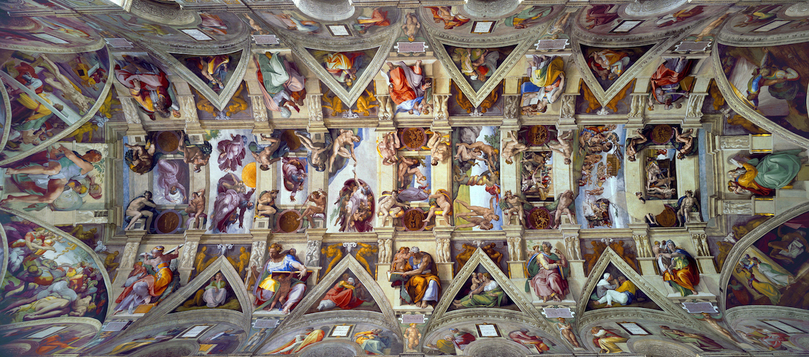

Slide 7





